Slide 1


Project I - Sales Forecasting
Disusun oleh
Dani Rahardjo
Machine Learning – Group A

Slide 2
Agenda
Overview
Prepare Dataset
Step-Step of Analysis
Preprocessing Data
Exploratory Data Analysis (EDA)
Modelling using Varmax
Modelling using LSTM

Slide 3
Overview
Dalam project ini bertujuan untuk melakukan analisa sales forecasting dengan mengambil data TOP 3 family (Grocery I, Beverages, Cleaning) berdasarkan jumlah sales pada sebuah store.
Adapun prediksi yang akan dilakukan menggunakan data histori sales, promotion, dcoilwtico.
Sebelum analisa lebih lanjut, perlu dilakukan proses Preprocessing terlebih dahulu seperti Checking missing values, checking missing date dan dilakukan Exploratory Data Analysis (EDA)
Model yang akan digunakan dalam melakukan analisa, yaitu VARMAX dan LSTM.

Slide 4
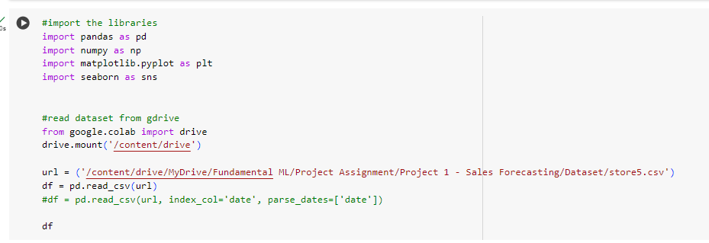
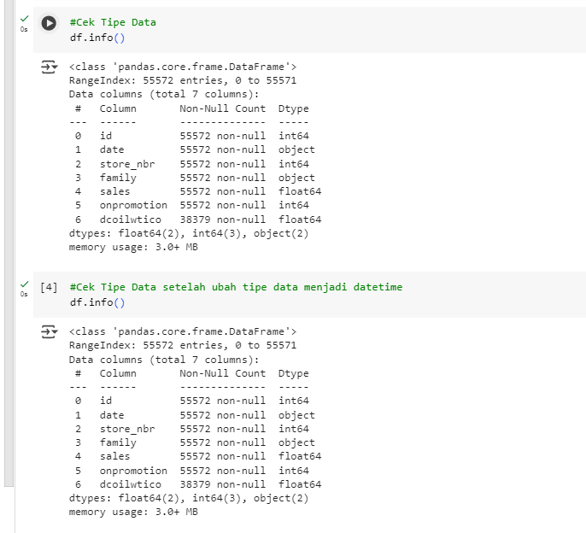
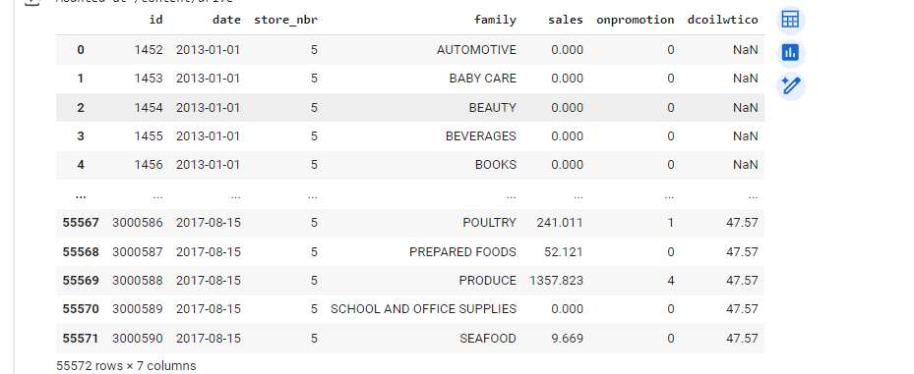
Prepare Dataset

Slide 5
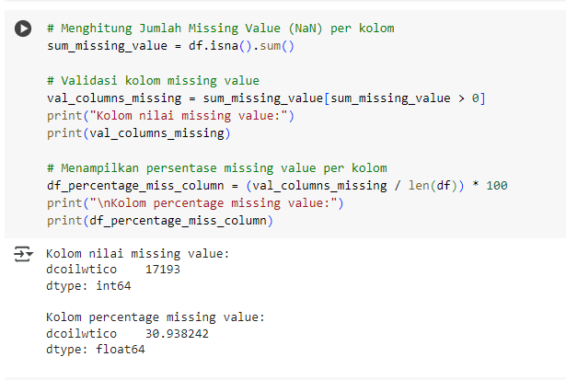
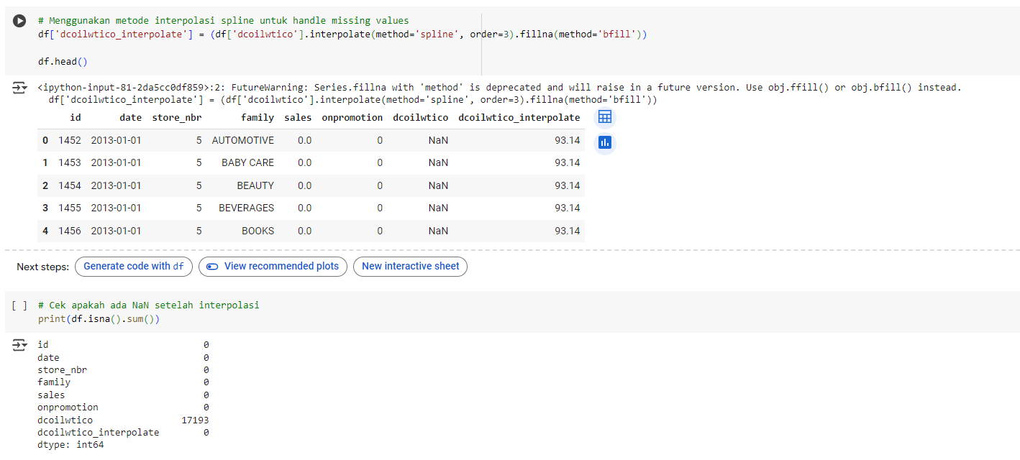
Preprocessing Data - Checking Missing Value

Slide 6
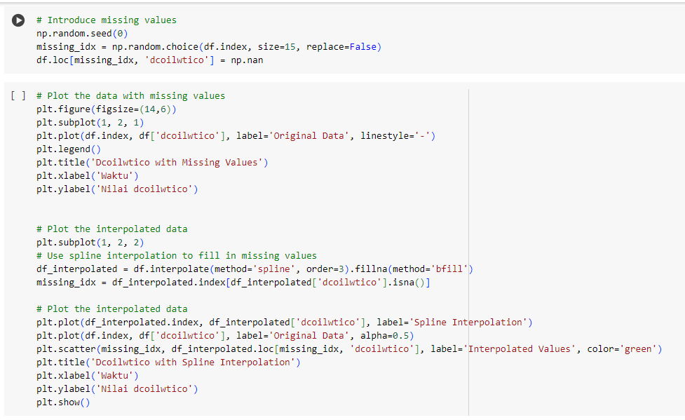
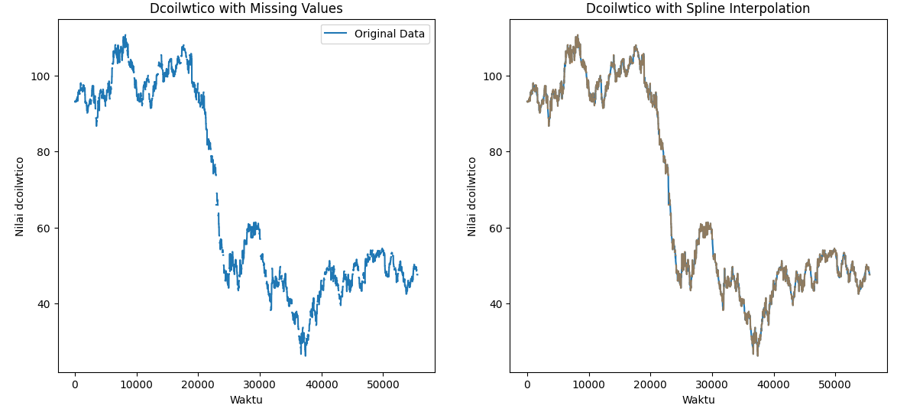
Preprocessing Data - Checking Missing Value
RESULT

Slide 7
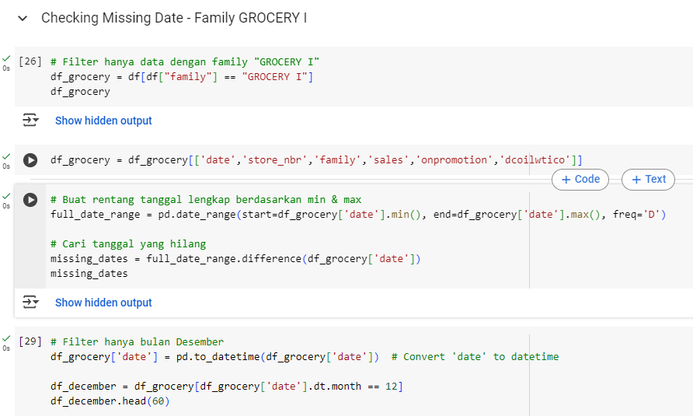
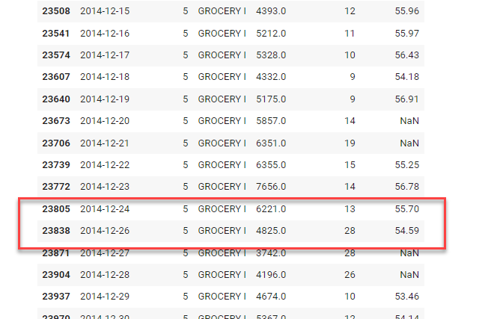
Preprocessing Data - Checking Missing Date
Missing date : 2024-12-25

Slide 8
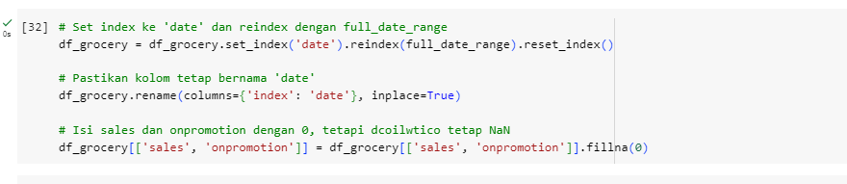
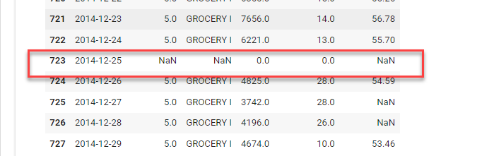
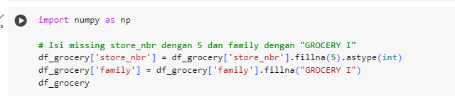
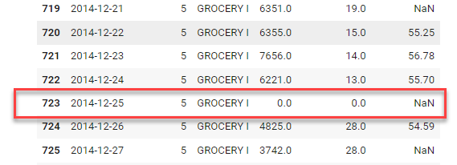
Preprocessing Data - Checking Missing Date

Slide 9
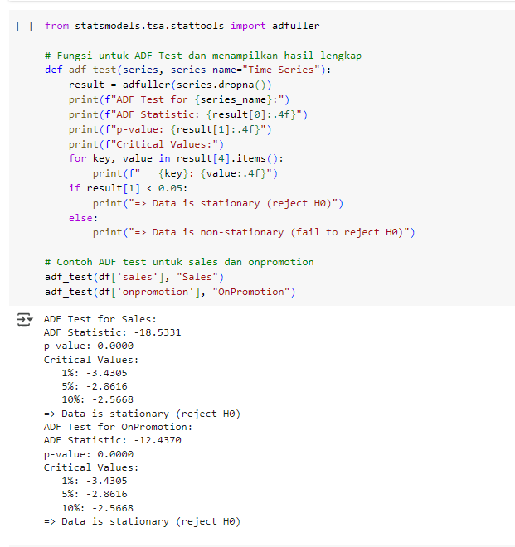
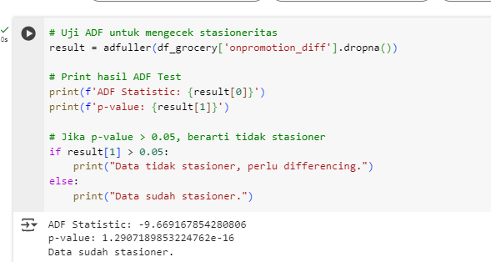
Exploratory Data Analysis (EDA) – Checking Stationary

Slide 10
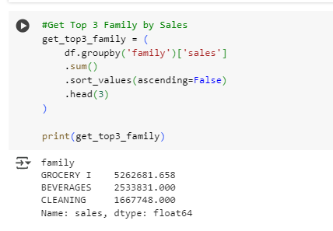
Exploratory Data Analysis (EDA) – Get Top 3 Family

Slide 11
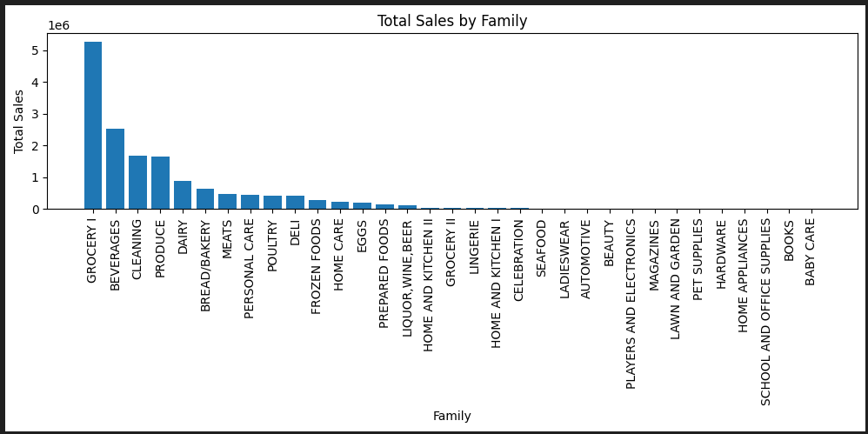
EDA – Fine the top 3 family

Slide 12
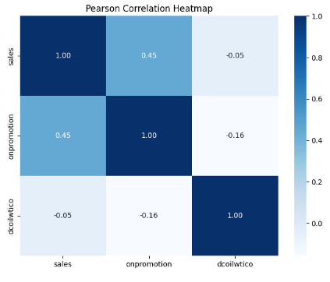
EDA - Heatmap
Onpromotion dan Sales berkorelasi relatif kuat

Slide 13
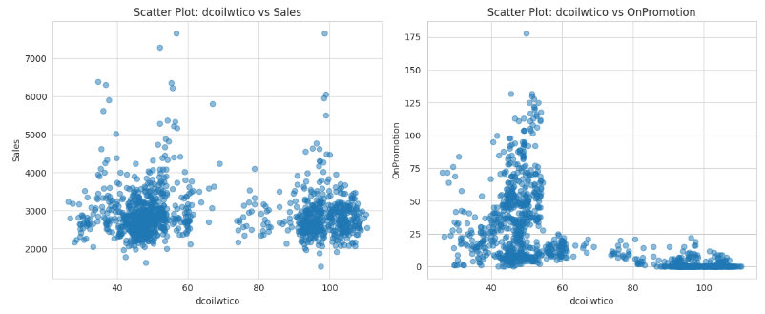
EDA - Interpolation
Found that no linear correlation between sales and dcoilwtico

Slide 14
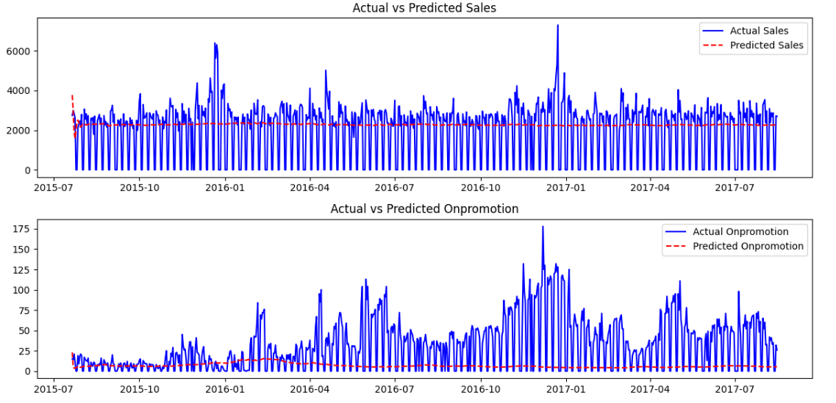
Modelling VARMAX MAE - Grocery I
Best VARMAX order: (3, 3) dengan Normalized MAE: 20.5098
Hasil Prediksi:

Slide 15
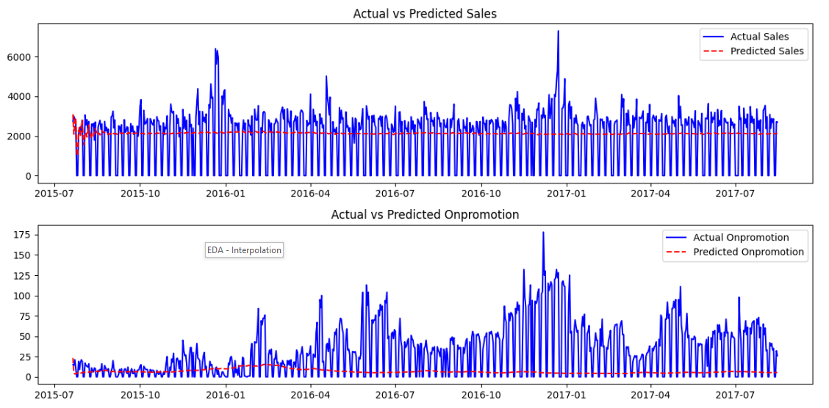
Modelling VARMAX RSME - Grocery I
Best VARMAX order: (3, 3) dengan Normalized RMSE: 29.1763
Final RMSE Sales: 1422.3214
Final RMSE Onpromotion: 40.0924
Hasil Prediksi:

Slide 16
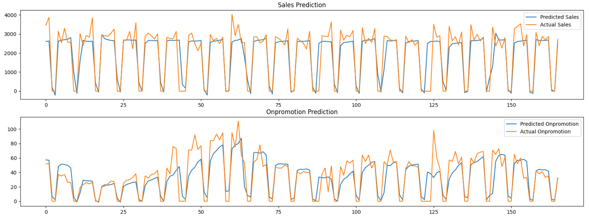
Modelling LSTM - Grocery I
Epochs=100, batch_size=35
Train Score for sales: 738.21 RMSE
Test Score for sales: 617.96 RMSE
Train Score for onpromotion: 10.73 RMSE
Test Score for onpromotion: 16.03 RMSE
Hasil Prediksi:

Slide 17
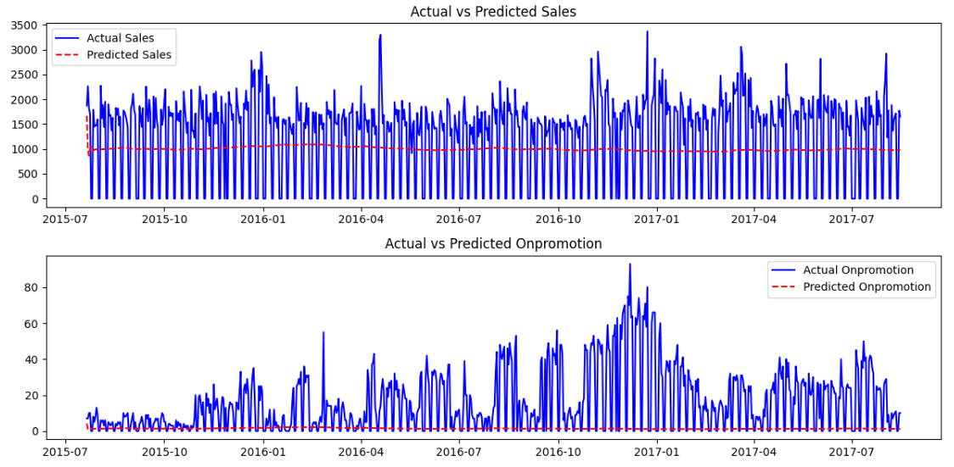
Modelling VARMAX MAE - Beverages
Best VARMAX order: (4, 3) dengan Normalized MAE: 16.7282
Hasil Prediksi:

Slide 18
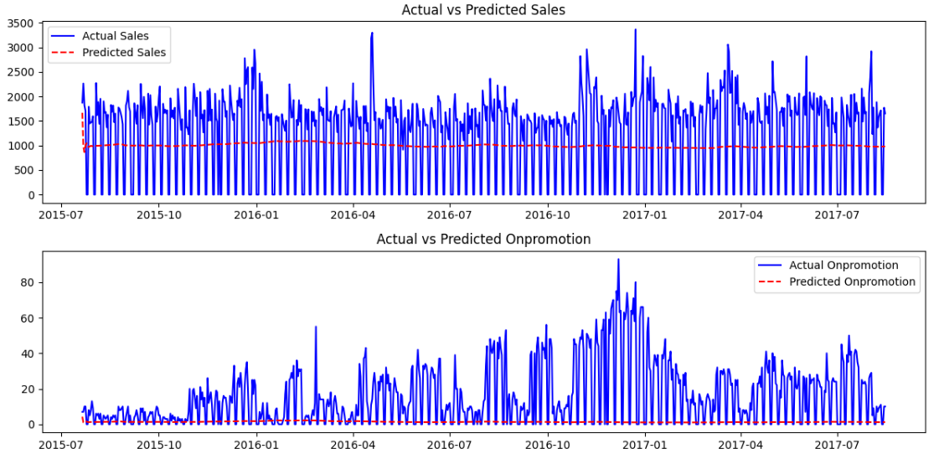
Modelling VARMAX RSME - Beverages
Best VARMAX order: (4, 3) dengan Normalized RMSE: 24.8053
Final RMSE Sales: 889.8373
Final RMSE Onpromotion: 22.4706
Hasil Prediksi:

Slide 19
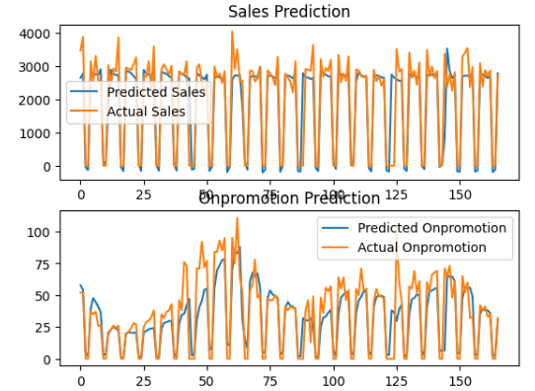
Modelling LSTM - Beverages
Epochs=100, batch_size=35
Train Score for sales: 699.60 RMSE
Test Score for sales: 585.64 RMSE
Train Score for onpromotion: 10.67 RMSE
Test Score for onpromotion: 15.57 RMSE
Hasil Prediksi:

Slide 20
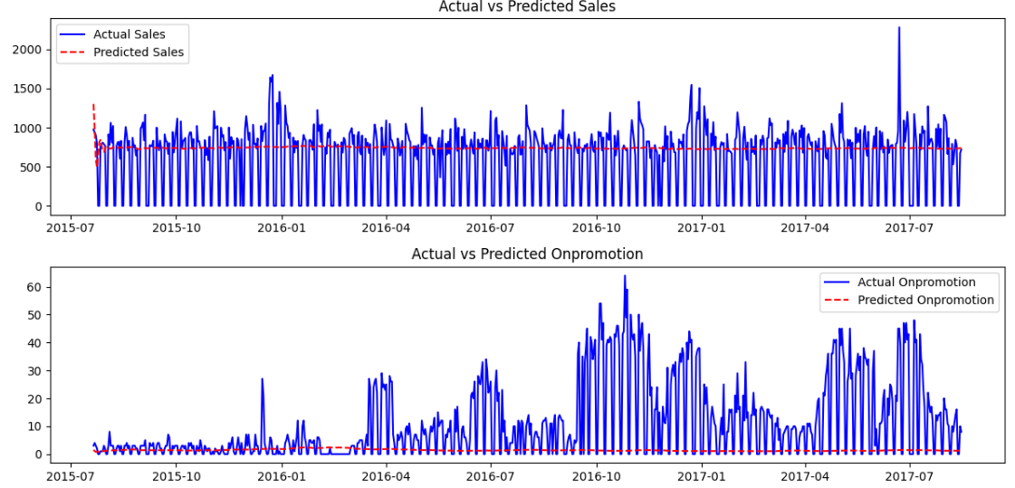
Modelling VARMAX MAE - Cleaning
Best VARMAX order: (3, 3) dengan Normalized MAE: 14.5540
Hasil Prediksi:

Slide 21
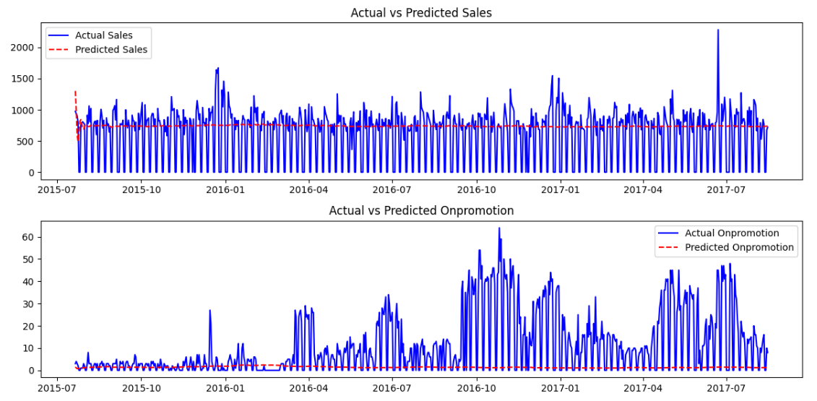
Modelling VARMAX RSME - Cleaning
Best VARMAX order: (3, 3) dengan Normalized RMSE: 23.3222
Final RMSE Sales: 450.6045
Final RMSE Onpromotion: 16.6275
Hasil Prediksi:

Slide 22
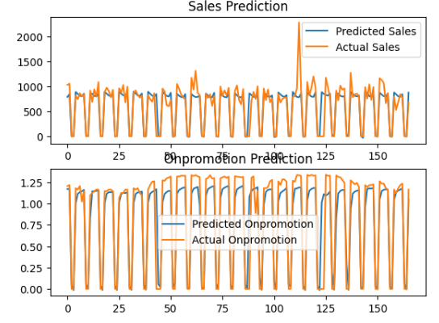
Modelling LSTM - Cleaning
Epochs=100, batch_size=35
Train Score for sales: 209.02 RMSE
Test Score for sales: 215.91 RMSE
Train Score for onpromotion: 0.19 RMSE
Test Score for onpromotion: 0.21 RMSE
Result Prediksi:

Slide 23
Kesimpulan
Nilai prediksi dengan menggunakan Modelling LSTM lebih optimal mendekati nilai Actual dibandingkan modelling Varmax
Perbandingan Family Grocery I Varmax RMSE vs LSTM
Varmax RMSE | LSTM
Train Score for sales: 738.21 RMSE
Test Score for sales: 617.96 RMSE
Train Score for onpromotion: 10.73 RMSE
Test Score for onpromotion: 16.03 RMSE
Final RMSE Sales: 1422.3214
Final RMSE Onpromotion: 40.0924

Slide 24
Kesimpulan
Perbandingan Family Beverages Varmax RMSE vs LSTM
Varmax RMSE | LSTM
Train Score for sales: 699.60 RMSE
Test Score for sales: 585.64 RMSE
Train Score for onpromotion: 10.67 RMSE
Test Score for onpromotion: 15.57 RMSE
Final RMSE Sales: 889.8373
Final RMSE Onpromotion: 22.4706

Slide 25
Kesimpulan
Perbandingan Family Cleaning Varmax RMSE vs LSTM
Varmax RMSE | LSTM
Train Score for sales: 209.02 RMSE
Test Score for sales: 215.91 RMSE
Train Score for onpromotion: 0.19 RMSE
Test Score for onpromotion: 0.21 RMSE
Final RMSE Sales: 450.6045
Final RMSE Onpromotion: 16.6275

Slide 26

THANK YOU

